Slide 1
INTERNET OF THINGS Design Methodology

Slide 2
STEP BY STEP
Design Methodology
01.
Purpose and Requirement Specification
04.
Information Model specification
03.
Domain Model specification
02.
Process specification
05.
Services specification

Slide 3
Steps 1: Purpose & Requirements Specification
The first step in loT system design methodology is to define the purpose and requirements of the system.
In this step, the system purpose, behavior and requirements (such as data collection requirements, data analysis requirements, system management requirements, data privacy and security requirements, user interface requirements..) are captured.

Slide 4
Steps 1: Purpose & Requirements Specification
Applying this to our example of a smart home automation system, the purpose and requirements for the system may be described as follows:
Purpose : A home automation system that allows controlling of the lights in a home remotely using a web application.
Behavior : The home automation system should have auto and manual modes. In auto mode, the system measures the light level in the room and switches on the light when it gets dark. In manual mode, the system provides the option of manually and remotely switching on/off the light.

Slide 5
Steps 1: Purpose & Requirements Specification
System Management Requirement : The system should provide remote monitoring and control functions.
Data Analysis Requirement : The system should perform local analysis of the data.
Application Deployment Requirement : The application should be deployed locally on the device, but should be accessible remotely.
Security Requirement : The system should have basic user authentication capability.

Slide 6
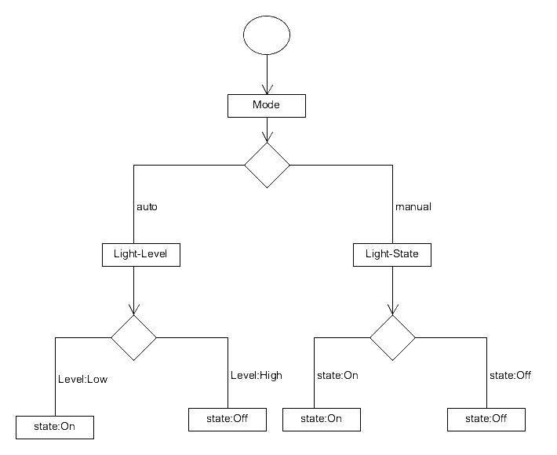
Steps 2: Process Specification
The second step in the IoT design methodology is to define the process specification.
In this step, the use cases of the IoT system are formally described based on and derived from the purpose and requirement specifications.

Slide 7
Steps 3: Domain Model Specification
The third step in the IoT design methodology is to define the Domain Model. The domain model describes the main concepts, entities and objects in the domain of IoT system to be designed.
Domain model defines the attributes of the objects and relationships between objects. Domain model provides an abstract representation of the concepts, objects and entities in the IoT domain, independent of any specific technology or platform.
With the domain model, the IoT system designers can get an understanding of the IoT domain for which the system is to be designed.

Slide 8
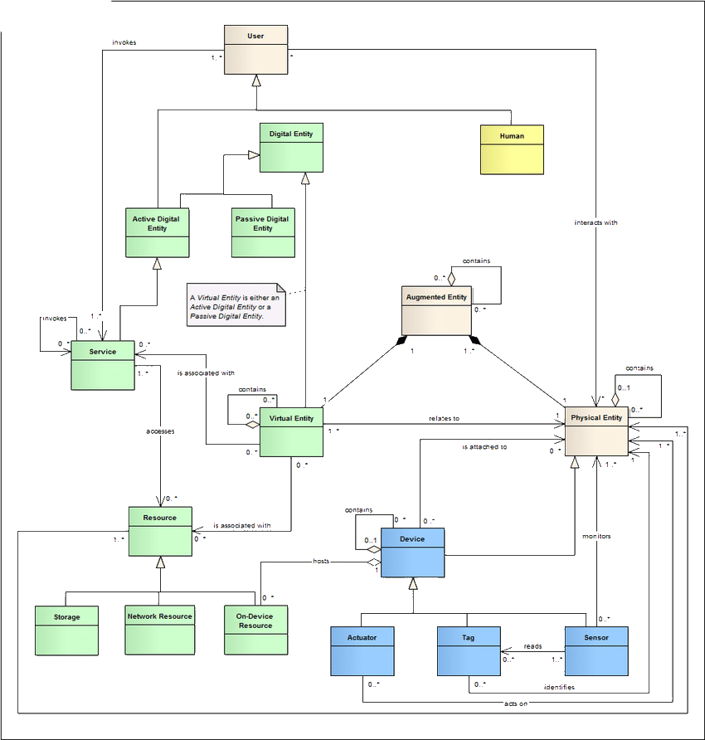
Steps 3: Domain Model Specification
Click Here

Slide 9
Steps 4: Information Model Specification
The fourth step in the IoT design methodology is to define the Information Model. Information Model defines the structure of all the information in the IoT system, for example, attributes of Virtual Entities, relations, etc.
Information model does not describe the specifics of how the information is represented or stored. To define the information model, we first list the Virtual Entities defined in the Domain Model.
Information model adds more details to the Virtual Entities by defining their attributes and relations.

Slide 10
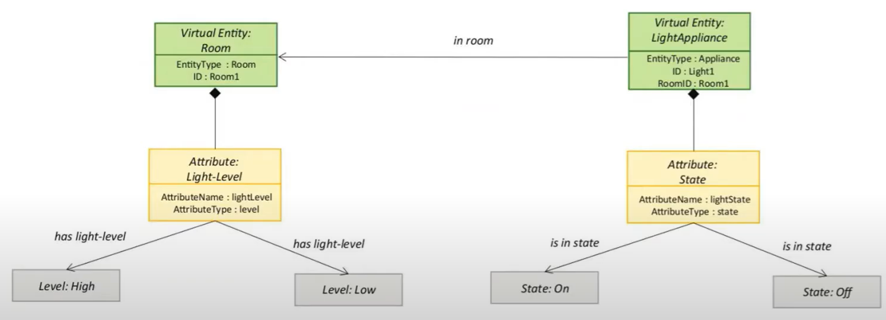
Steps 4: Information Model Specification
Click Here

Slide 11
Steps 5: Service Specifications
The fifth step in the IoT design methodology is to define the service specifications.
Service specifications define the services in the IoT system, service types, service inputs/output, service endpoints, service schedules, service preconditions and service effects.

Slide 12
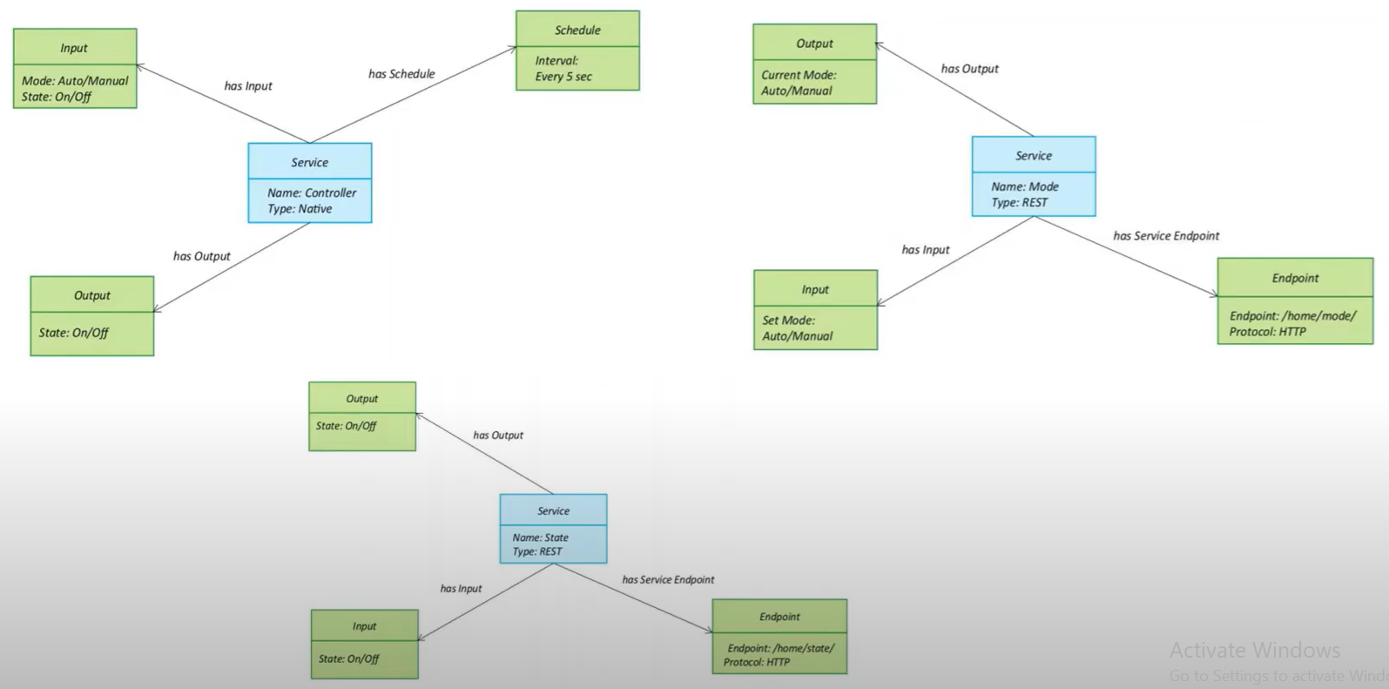
Steps 5: Service Specifications
Click Here

Slide 13
THANK YOU

